Slide 1
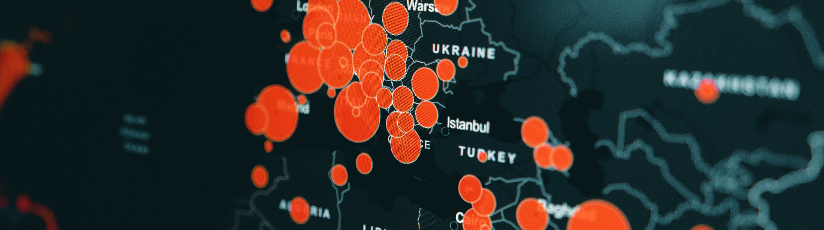
Data Analysis Report for Fond Rouge
Shrishti Vaish, SAP
Month 08, 2023

Slide 2
Data Analysis Report for Fond Rouge
Speaker’s Name, SAP
Month 00, 2021

Slide 3

Data Analysis Report for Fond Rouge
Speaker’s Name, SAP
Month 00, 2021

Slide 4
Agenda
Sentiment Analysis and Classification in the US
Understanding the Concept of NEG Class-ifiers.
Calculating the % NEG Class-ifiers in the US (30.99%).
Displaying the Donut Chart of Sentiment Class in the US (Screenshot).
Global Sentiment Analysis
Exploring Global Sentiment Analysis.
Computing the % NEG Class-ifiers Globally (4.25%).
Visualizing the Donut Chart of Sentiment Class Globally (Screenshot).
Revenue and Returns Analysis by City
Identifying the City with the Highest % Revenue Loss due to Returns (San Diego).
Presenting the Stacked Bar Chart of Revenue & Refund per US City (Screenshot).
Counterfeiting and Customer Satisfaction in US Locations
Investigating Counterfeiting Possibilities.
Identifying Locations with Potential Counterfeiting Issues (Los Angeles, Las Vegas).
Showcasing the Column & Line Chart of Refund/Revenue & Avg Sentiment per US City (Screenshot).
Analyzing Customer Satisfaction and Returns for Different US Locations.
Highlighting the Diversity of Problems Faced by Fond Rouge (San Diego, Atlanta, New York, LA, Vegas).

Slide 5


Data Analysis Report for Fond Rouge
Shrishti Vaish, SAP
August 14, 2023

Slide 6
Agenda
Revenue and Returns Analysis by City
Sentiment Analysis and Classification in the US
Global Sentiment Analysis
Counterfeiting and Customer Satisfaction in US Locations

Slide 7
Revenue and Returns Analysis by City

Slide 8
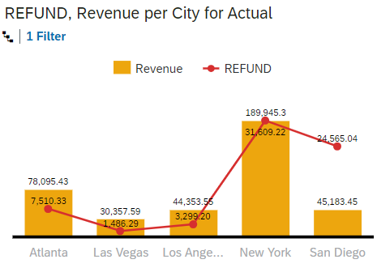
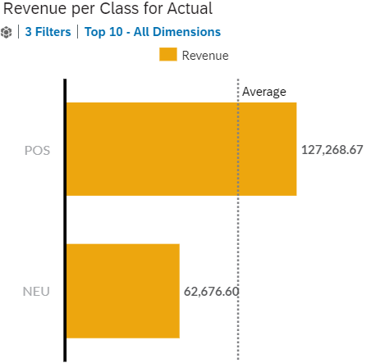
San Diego loses the highest % revenue due to returns.
New York has the highest Revenue.
POS is the top contributor, 34% above average.

Slide 9
Sentiment Analysis and Classification in the US

Slide 10
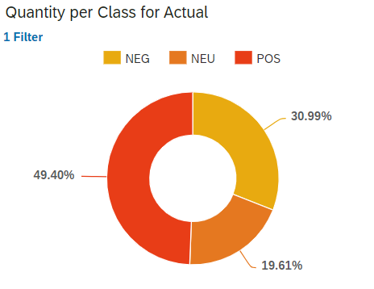
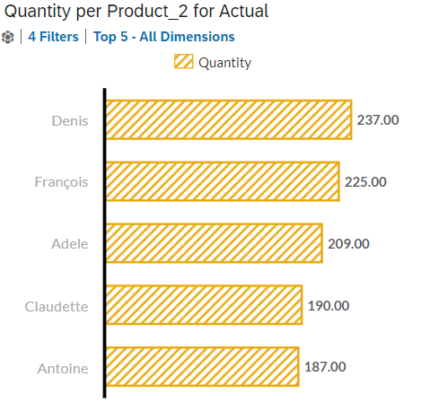
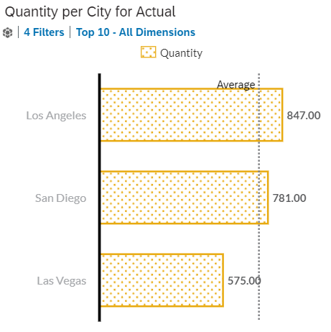
30.99% of Negative(NEG) sentiments across the US locations.
Denis is the top contributor product with the Negative sentiment
Los Angeles is the top contributor city with the Negative sentiment
Notes:
NEG Class-ifiers are used to categorize sales or transactions based on their sentiment, particularly identifying those that exhibit a negative sentiment.
This involves determining the proportion of sales that have been classified as having negative sentiment, both for the US and for the entire dataset, and presenting this percentage as an insight into customer dissatisfaction or negative feedback trends.

Slide 11
Global Sentiment Analysis

Slide 12
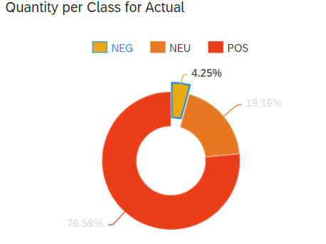
4.25% of the Global Negative sentiment score.
Denis is the top contributor product with the Negative sentiment globally
Los Angeles is the top contributor city with the Negative sentiment globally

Slide 13
Counterfeiting and Customer Satisfaction in US

Slide 14
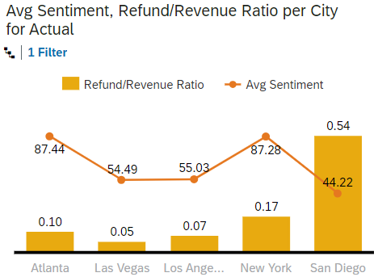
Los Angeles & Las Vegas are the 2 cities where the returns are lower than 20%, but the Sentiment is low (under 65))
Fond Rouge does not have a problem in all of its American locations because places like Atlanta and New York have less than 20% of return/revenue ratio and their Avg. sentiment score is above.
Counterfeit is not the only problem, however, despite having low returns in Atlanta and New York, its important to investigate other reasons for customer dissatisfaction.

Slide 15

Thank you.
Contact information:
Shristi Vaish
SAP Consultant

Slide 16
Insert page title (sentence case)

Slide 17
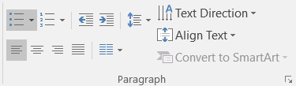
Insert page title (sentence case)
First level
Second level
Third level
NOTE: Delete the yellow stickers when finished.
The text placeholders have different, preformatted text levels. Each level has different formatting (font size, indent, bullet).
To jump between the preformatted text levels, use the Increase List Level and Decrease List Level buttons in the Paragraph toolbar.
Type your text in the placeholder.
Click the Increase List Level button in the Paragraph toolbar to go to the next level.
If you need a bullet list, choose level 2.
Avoid working with spaces, other bullets, or bullets in the wrong level. Only when you use the right levels it is possible to reset the slide layout.

Slide 18

Divider page

Slide 19
Insert page title (sentence case)
First level
Second level
Third level

Slide 20
Insert page title (sentence case) Subheadline
First level
Second level
Third level

Slide 21
“Quote goes here and here and here.”
Source

Slide 22
“Quote goes here and here and here.”
Source

Slide 23
Insert page title (sentence case)
First level
Second level
Third level

Slide 24
Insert page title (sentence case)
First level
Second level
Third level

Slide 26
Insert page title (sentence case)
First level
Second level
Third level
First level
Second level
Third level

Slide 27
Insert page title (sentence case)
First level
Second level
Third level
First level
Second level
Third level
First level
Second level
Third level

Slide 28
Insert page title (sentence case)
First level
Second level
First level
Second level

Slide 29
Insert page title (sentence case)
First level
Second level
First level
Second level
First level
Second level

